Slide 1
INNOVATION IN PYTHON FOR DATA SCIENCE

Slide 2
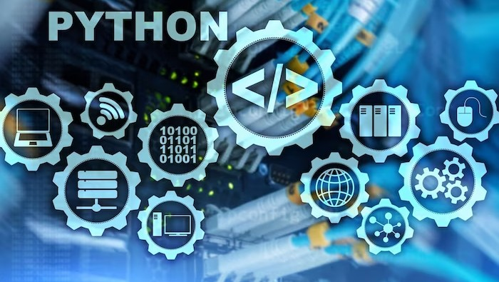
Introduction
Welcome to the world of Python Pioneers! In this presentation, we will explore how Python has revolutionized the ﬁeld of Data Science. From its simplicity and versatility to its rich ecosystem of libraries, Python has become the go-to language for data scientists worldwide. Join us on this journey as we uncover the power of Python in unleashing innovation in the realm of data science.

Slide 3

PYTHON INNOVATION IN DATA FIELD
The rich ecosystem of Python libraries has played a signiﬁcant role in its dominance in data science. From NumPy and Pandas for data manipulation, to Matplotlib and Seaborn for visualization, to TensorFlow and PyTorch for deep learning, Python offers a vast collection of powerful tools that accelerate the data science workﬂow. This ecosystem fosters innovation by providing data scientists with the building blocks they need to create groundbreaking solutions.

Slide 4

PYTORCH AND TENSOR FLOW
These deep learning frameworks continue to evolve with innovative features for neural network research and development. PyTorch, in particular, has gained popularity for its dynamic computation graph

Slide 5
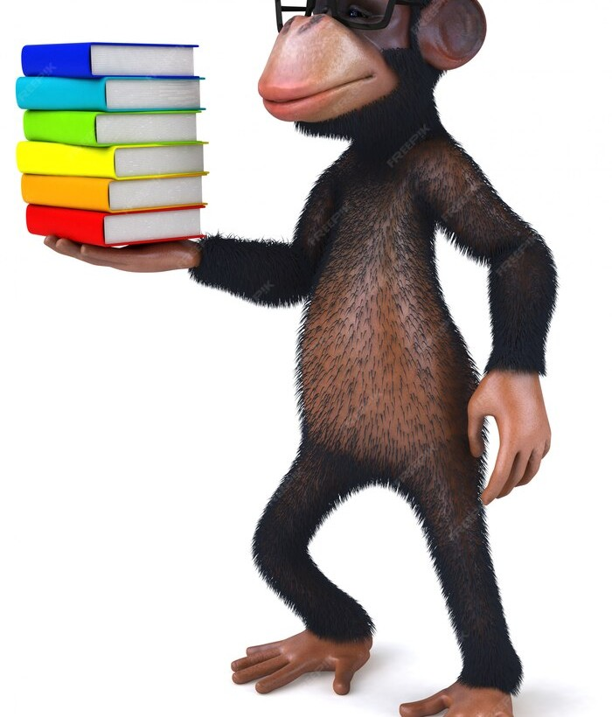
CAUSAL INFERENCE LIBRARIES
Libraries like causalnex and dowhy enable data scientists to perform causal inference and understand cause-and-effect relationships in their data.

Slide 6

JupyterLab and xarray
JupyterLab
JupyterLab is an evolution of the Jupyter Notebook
that provides a more interactive and
ﬂexible environment for data science. It allows you to
combine code, data, and visualizations in one interface.
Xarray
Xarray is a library designed for working with labeled, multi-dimensional arrays. It's particularly useful for handling complex datasets such as climate data or geospatial data.

Slide 7
Prefect
Prefect is a workﬂow management system for building, scheduling, and monitoring data pipelines. It helps streamline and automate data processing tasks.
Streamlit
Streamlit is a framework for building interactive web applications with minimal code. Data scientists can use it to
quickly create and share data-driven apps.
Optuna
Optuna is a hyperparameter optimization framework that automates the process of tuning machine learning models, making it easier to ﬁnd optimal model conﬁgurations.

Slide 8
CONCLUSION
In conclusion, Python has emerged as the language of choice for data scientists, enabling them to unleash innovation in the ﬁeld of data science. Its simplicity, versatility, and rich ecosystem empower data scientists to tackle complex problems and drive advancements that shape the future. As Python continues to evolve, we can expect even more exciting possibilities and breakthroughs in the world of data science.

